Slide 1

Image Enhancement and CLAHE Algorithm
Welcome to this presentation exploring the world of image enhancement and the powerful CLAHE algorithm. We will delve into the importance of image enhancement, its core principles, and the inner workings of the CLAHE algorithm. We will also discuss its advantages and applications across diverse fields.
Name & USN:
Tarun Ranganath Bombalekar (ENG22CS0197)
Veeresha R (ENG22CS0204)
Rakesh Rathod (ENG22CS0133)

Slide 2
Understanding Image Enhancement
Definition
Image enhancement refers to the process of improving the visual quality of images, often by enhancing contrast, sharpness, and detail.
Purpose
It aims to make images easier to interpret, analyze, and process by enhancing specific features and suppressing unwanted noise.

Slide 3
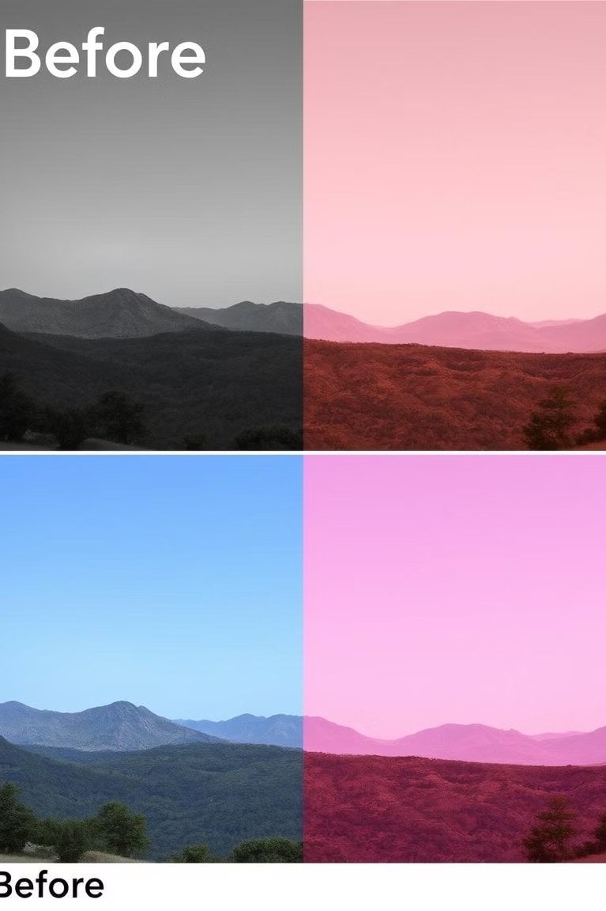
The Need for Image Enhancement
Poor Lighting
Enhancement helps improve visibility in low-light conditions, enhancing detail and clarity.
Image Degradation
It can restore clarity to images affected by noise, blur, or compression artifacts.
Visual Analysis
It aids in medical imaging, satellite imagery, and object detection by making critical features more prominent.

Slide 4
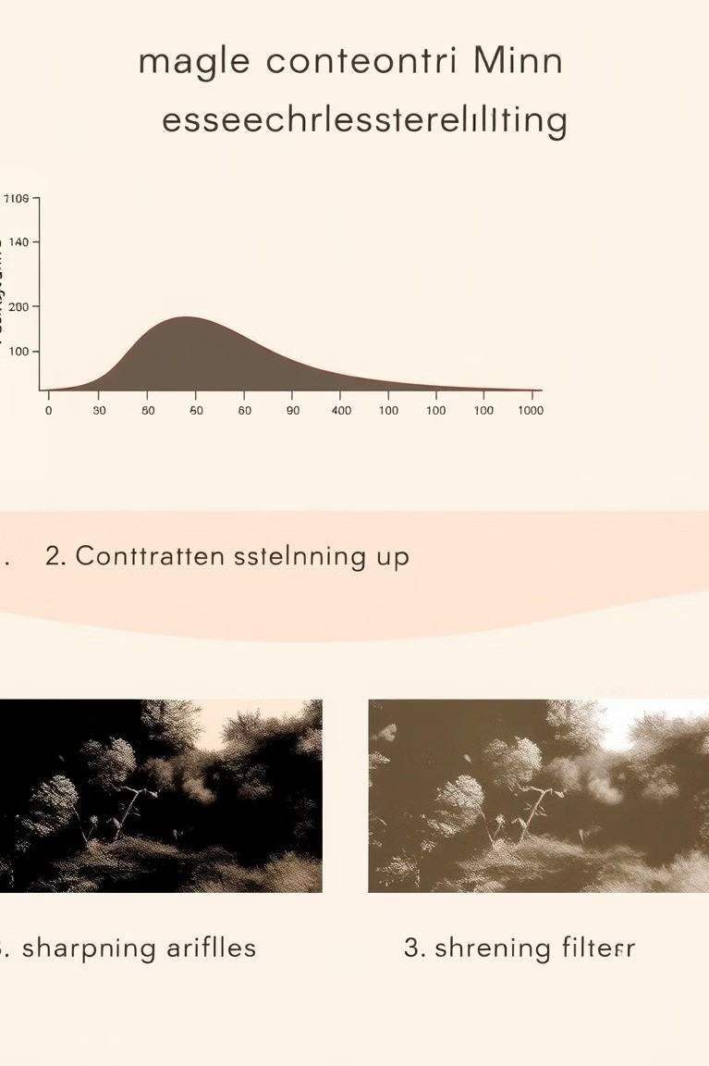
Principles of Image Enhancement
Contrast Enhancement
Increases the difference between light and dark areas, making details more visible.
Sharpening
Enhances edges and boundaries, making objects appear more defined.
Noise Reduction
Reduces unwanted noise and artifacts, improving image clarity and detail.

Slide 5

Introduction to CLAHE Algorithm
Histogram Equalization
CLAHE is an advanced form of histogram equalization, a technique used to enhance contrast.
Contrast Enhancement
CLAHE aims to distribute pixel intensities more evenly, boosting overall image contrast.
Local Adaptation
It operates on smaller regions of the image, adaptively adjusting contrast for better detail preservation.

Slide 6
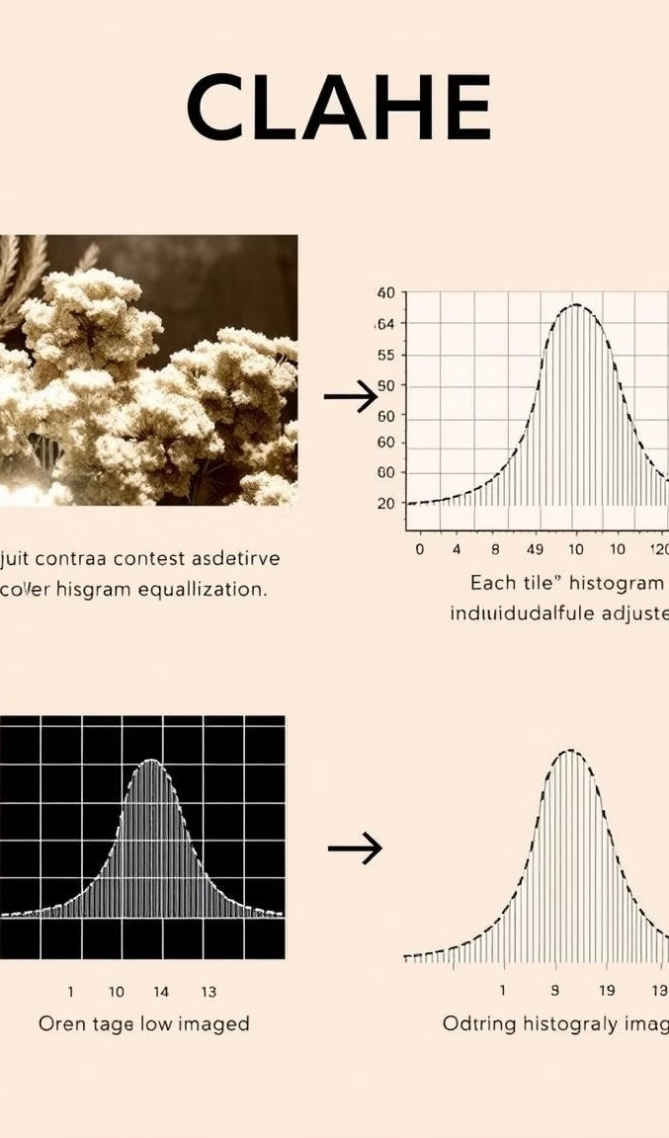
How CLAHE Works
1
Divide Image
The image is divided into smaller blocks, each representing a local region.
2
Calculate Histogram
A histogram is calculated for each block, analyzing the distribution of pixel intensities.
3
Equalize Histogram
The histogram is equalized within each block, spreading out intensities for better contrast.
4
Combine Blocks
The equalized blocks are combined to create the final enhanced image.

Slide 7

Advantages of CLAHE
Enhanced Contrast
CLAHE effectively enhances contrast, making details more visible in low-light or high-contrast areas.
1
Preserved Detail
It avoids over-enhancing details, preventing distortion or blurring, unlike traditional histogram equalization.
2
Local Adaptation
CLAHE's localized approach ensures that different regions of the image are enhanced appropriately.
3

Slide 8
Practical Applications of CLAHE
Medical Imaging
Enhancing contrast in medical images like X-rays and MRIs.
1
Surveillance
Improving visibility in low-light security footage, aiding in object identification.
2
Satellite Imagery
Enhancing features in satellite images for land-use analysis and environmental monitoring.
3

Slide 9
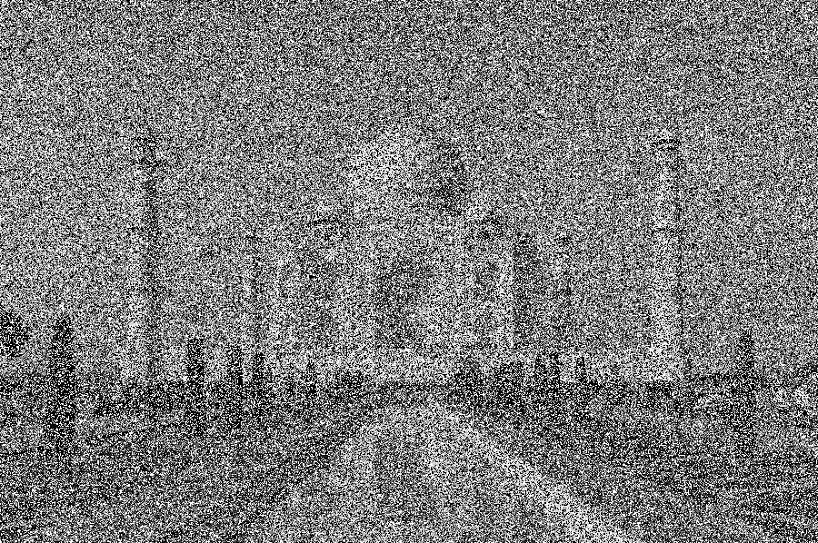
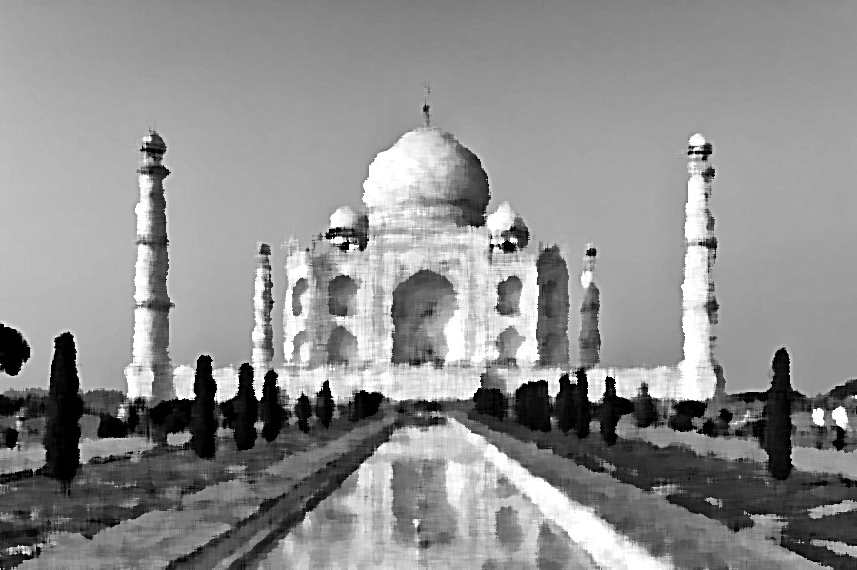
Before After

Slide 10

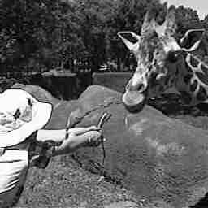
Before After

Slide 11
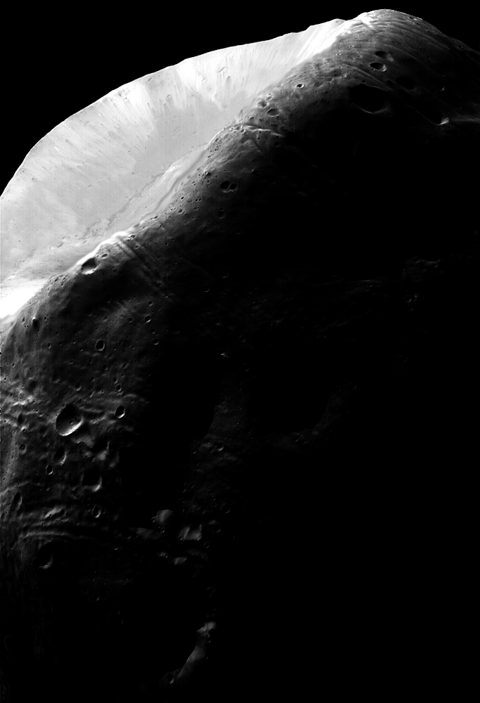
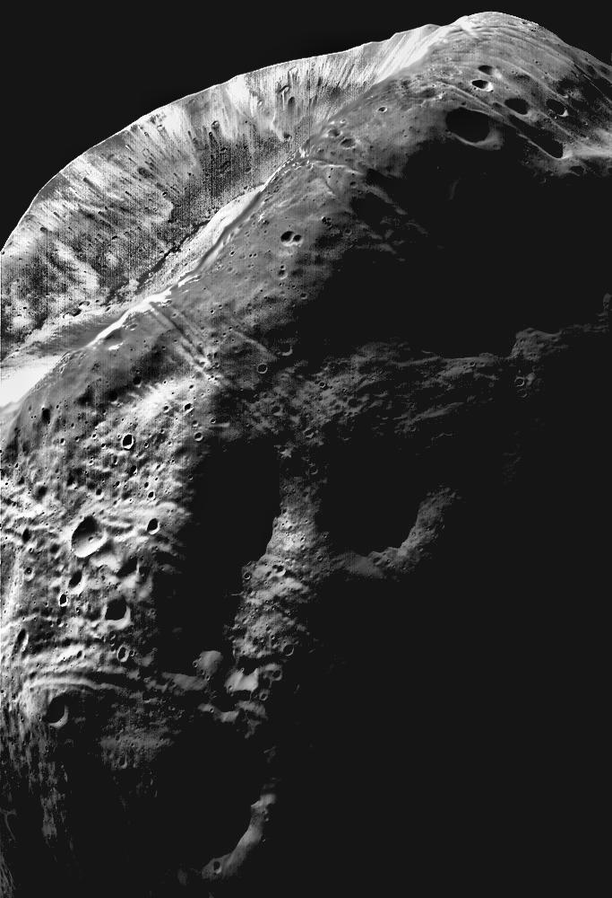
Before After

Slide 12
Conclusion and Key Takeaways
Image Enhancement
A powerful tool for improving image quality and revealing hidden details.
1
CLAHE
An advanced algorithm that provides excellent contrast enhancement while preserving detail.
2
Applications
CLAHE finds wide application in diverse fields like medical imaging, surveillance, and remote sensing.
3

